Slide 1
Agile Scrum

Slide 2
Agile Scrum
Lightweight
Simple to understand
Difficult to master
iterative

Slide 3
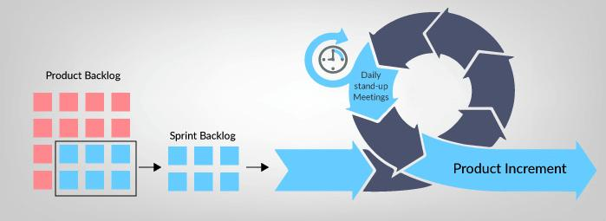
What is a Sprint?
A sprint is a time-boxed event in which work takes place.
Sprint backlog
product backlog

Slide 4
Sprint Backlog
Product Backlog items selected for the Sprint
“To be completed”, “In progress” and “Done”
roles
Project Manager (PM)
Product Owner (PO)
Business Analyst (BA)
Development Team
Scrum Master (SM)
Stakeholder

Slide 5
Sprint Planning Meeting
This meeting is held at the beginning of the sprint.
decide what is going to be brought into the sprint backlog
decide how the items they have brought in are going to be completed.

Slide 6
Daily Standup
A quick daily 15 minute meeting.
What did I do yesterday that helped meet the Sprint Goal?
What will I do today to help meet the Sprint Goal?
Do I see any future impediments that prevents the team from meeting the Sprint Goal?

Slide 7
Sprint Review Meeting
The development team demonstrate what work was done, and answer any questions.
The product owner discusses the Product Backlog as it stands.
The entire group collaborates on what to do next, to provide valuable input to subsequent Sprint Planning.

Slide 8
Sprint Retrospective Meeting
Inspect how the last Sprint went with regards to people, relationships, process, and tools
Identify and that went well and potential improvements
Create a plan for implementing improvements to the way the Scrum Team does its work.

Slide 9
Product Backlog Items
User stories​
Use cases​
Bugs, errors and fixes​
Constraints​

Slide 10
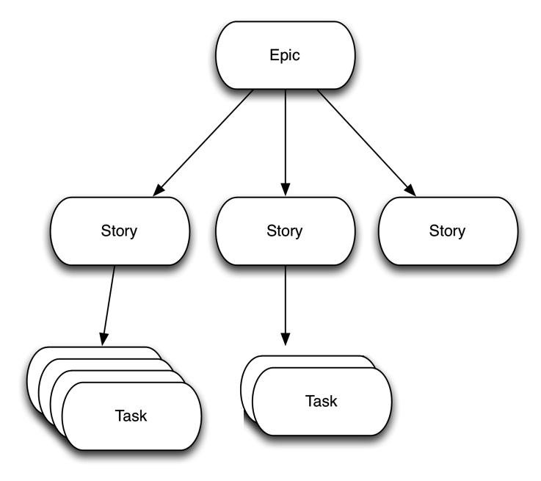
User Story
Focuses on what they want to do rather than how to do it​
These users can be external or internal​
They should be expressed in simple language that everyone can understand​
An Epic is made up of multiple user stories.

Slide 11
Definition of Ready (DoR)
what a product backlog item needs before it can go into the sprint backlog.
Technical details have been discussed on the item and agreed
Assigning a priority
Timing Estimates

Slide 12
Definition of Done (DoD)
defines what is needed before it can be regarded as complete.
Unit testing written and passed.
Documentation updated
Peer code review completed

Slide 13
Acceptance Criteria
dictates the conditions for software to be considered done
attached to our user stories to understand what a feature needs

Slide 14
Writing a User Story
When writing user stories, we typically want to state the following:
Who is performing the action
What action do they want to perform
What is the value of this action

